Slide 1

Opinion Mining: Information Extraction for Product Development
Ayan Karim

Slide 2

Business Problem
Any company that sells a product in mass production generates a huge amount of public opinion on the product and tons of reviews, articles, reactions and overall sentiments are posted online, especially soon after release.
As of 2017, 223 million iPhones were sold in the US, which is huge considering the population was 325 million (this information was from 2017)!
How do companies access this data from the public media and turn it into something useful? How do we extract all that diverse information from the web and analyze it??

Slide 3
Introduction
What is Opinion Mining?
What is Aspect-Based Sentiment Analysis

Slide 4
Let’s Pretend We’re Apple!
What does Public Opinion tell us about the iPhone X?
What do people dislike about the iPhone X?
How does our product compare with that of a competing smartphone like the Samsung Galaxy S9?

Slide 5
Pipeline
1. Collect Data
Scrape text data from the web
Process texts
2. Topic Modeling
Latent Dirichlet Allocation to extract and assign topics
ML classifiers trained on text data and topics (as labels)
3. Aspect-Based Semantic Analysis
Model text to extract Sentiments and Aspects, grouped by topics
Matplotlib and Seaborn to Visualize results

Slide 6



1. 2. Collecting Data and Topic Modeling

Slide 7
digitaltrends.com gizmodo.com techradar.com
1. iPhone X
2. Galaxy S9
3. Pixel 3
4. Huawei Mate 20 Pro
5. OnePlus 6T
6. Huawei P2 Pro
7. LG V4 Thinq
8. Sony Xperia XZ3
9. Essential Phone
10. Razer Phone 2
11. HTC U12+
12. Moto G6 plus

Slide 8
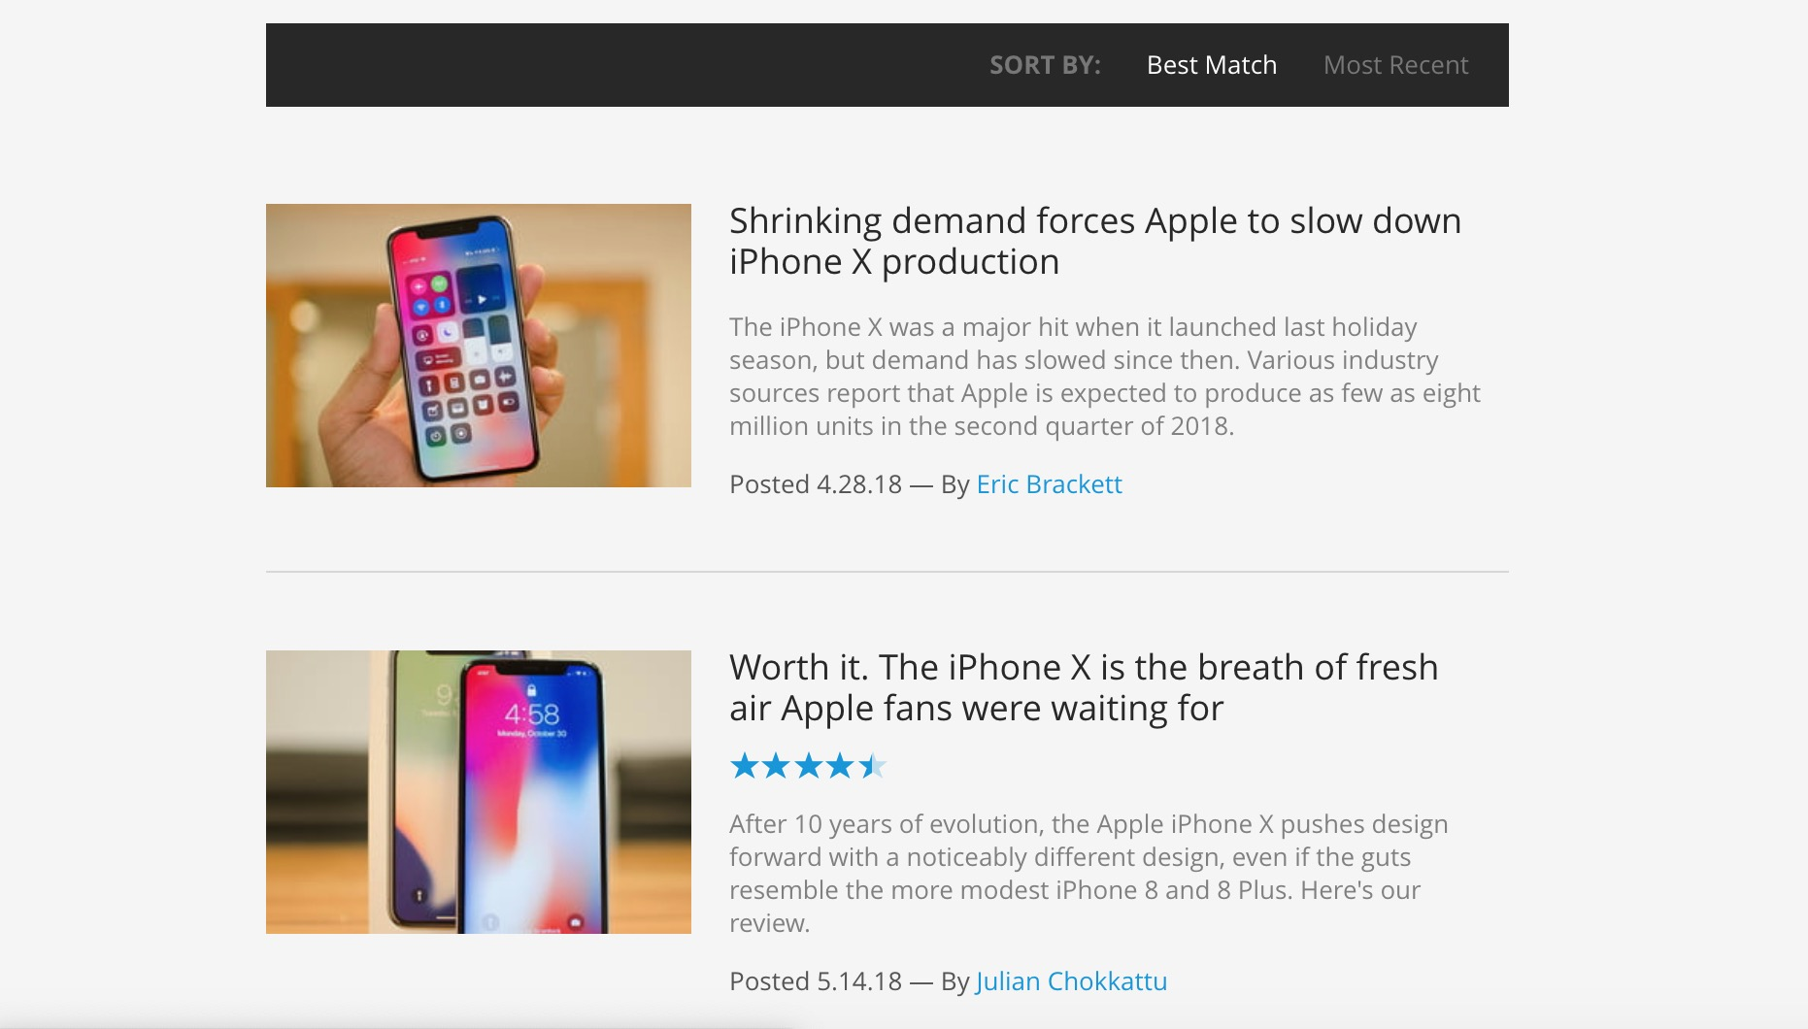

Slide 9
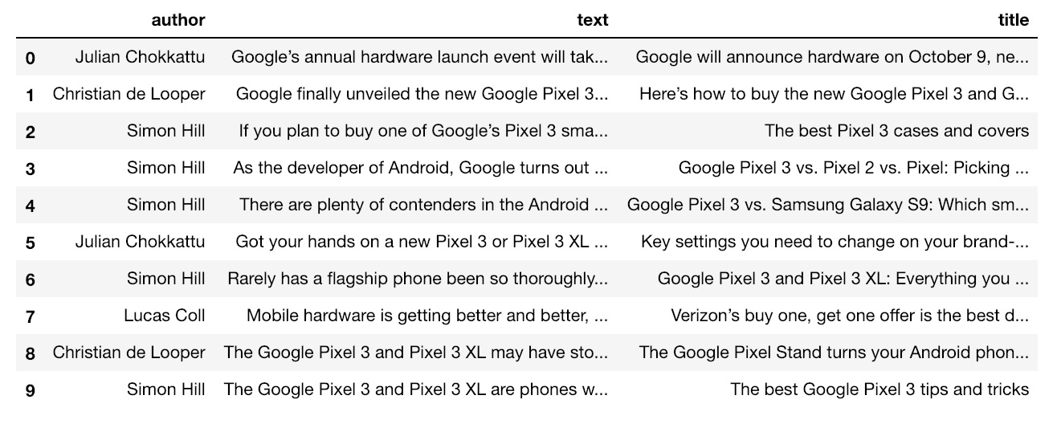

Slide 10
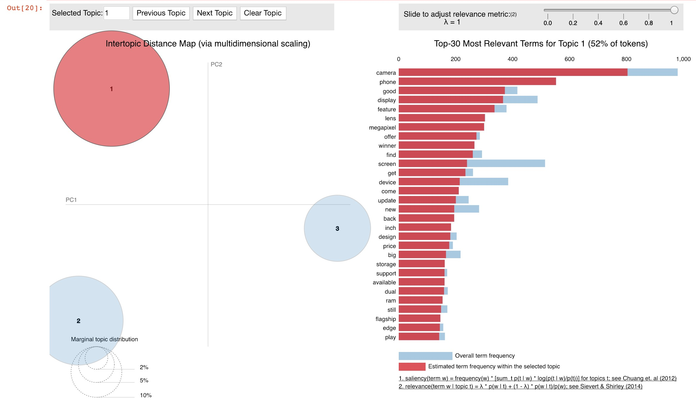

Slide 11
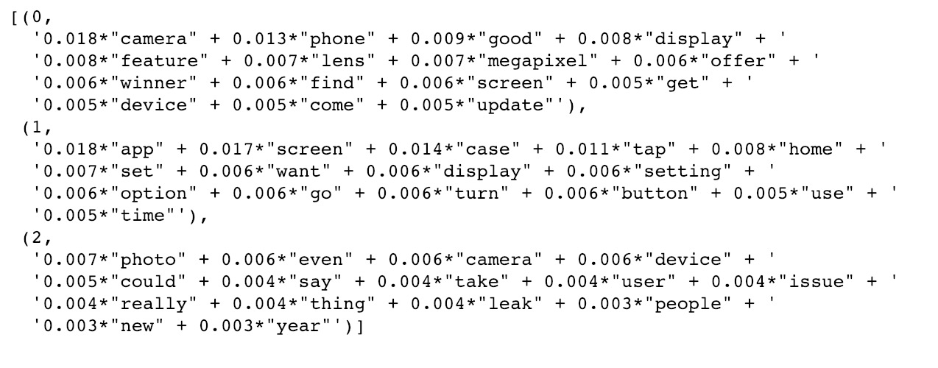
Latent Dirichlet Allocation

Slide 12
Labels
Design
Function
Reliability

Slide 13
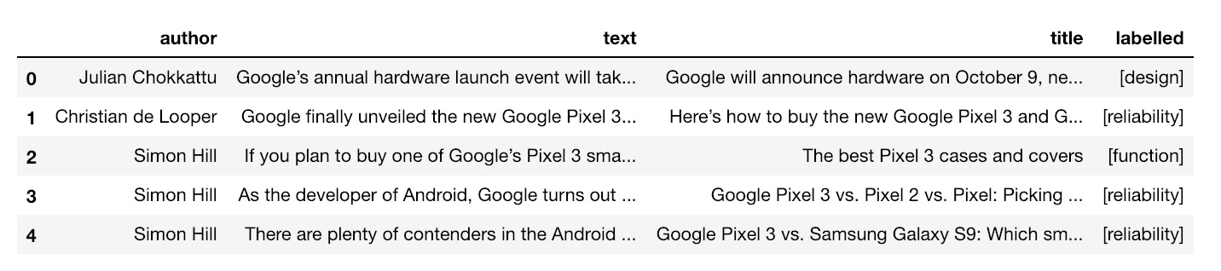
Assign Labels

Slide 14
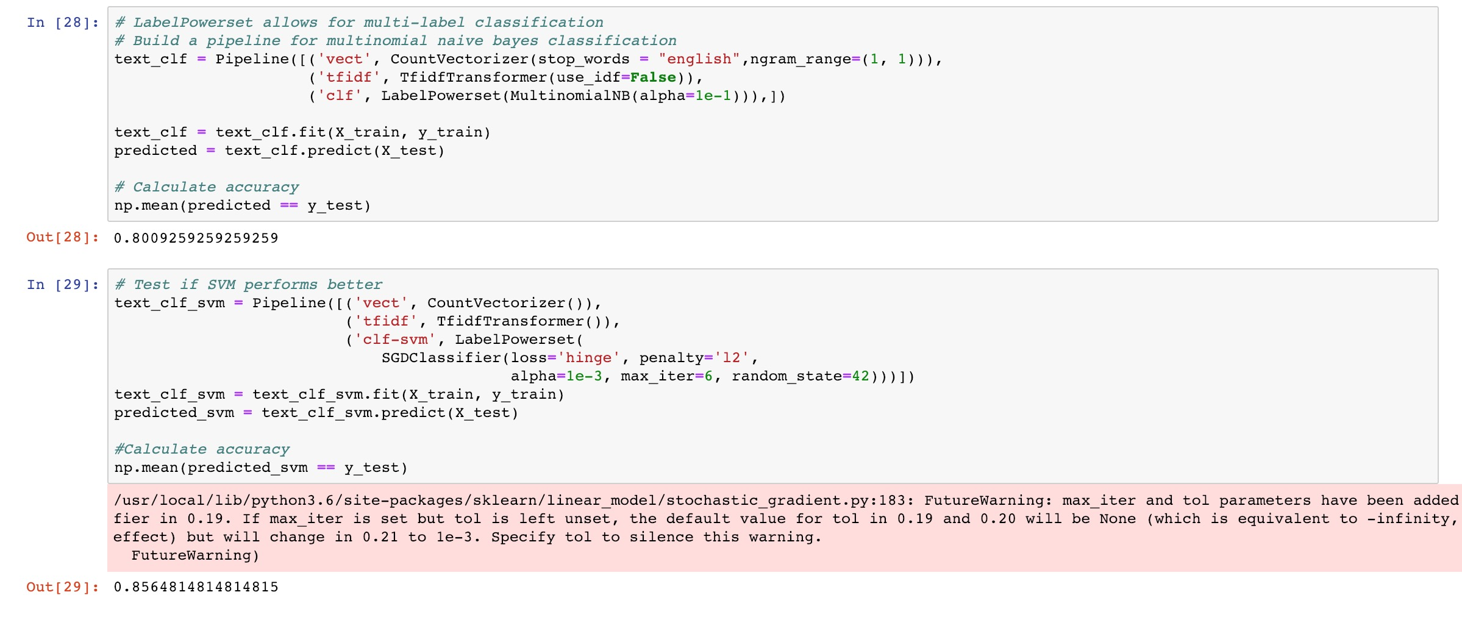
Multi-Label Support Vector Machine Classifier

Slide 15
3. Aspect-Based Sentiment Analysis

Slide 16
digitaltrends.com gizmodo.com techradar.com
1. iPhone X
2. Galaxy S9

Slide 17
Aspect-Based Sent. Analysis Pipeline
Extract
Extract Aspect and Sentiment.
“The screen is ugly”
“The apps are smooth”
Score and Classify
Score Terms and Sentiments then Classify them into Topics.
{Design: {“screen”: -1}, Function: {“buttons”: 1}}
Visualize
Visualize Topics, Aspects and Sentiments.

Slide 18
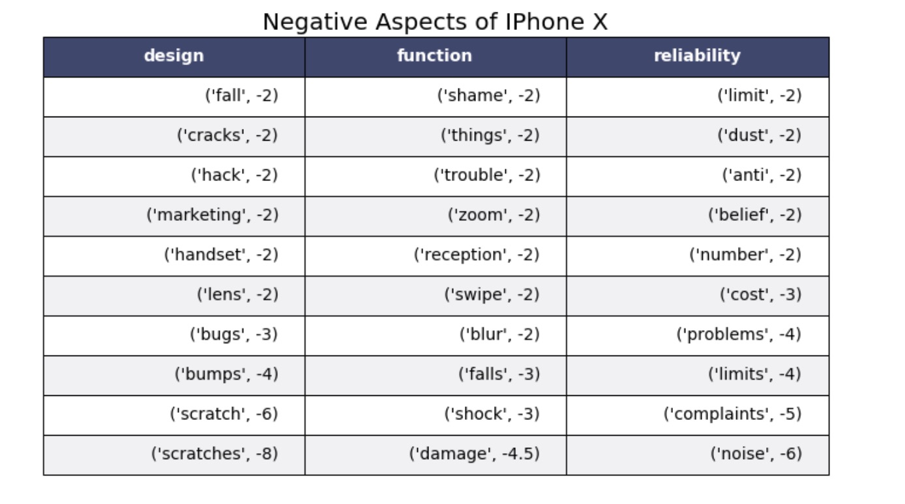
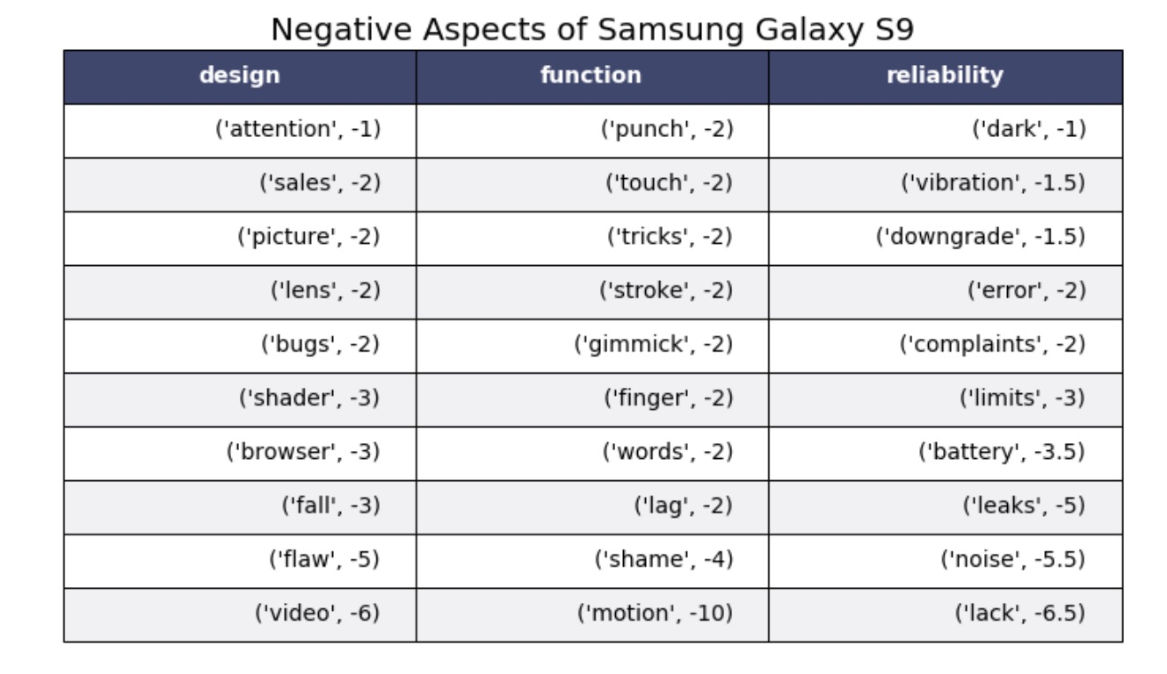
Visualize Topics, Aspects and Sentiments.

Slide 19
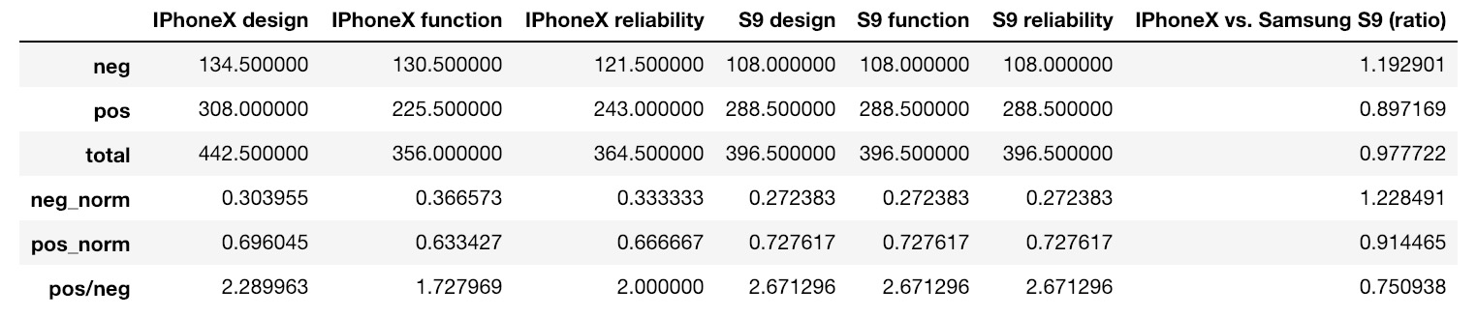
iPhone X vs. Samsung Galaxy S9

Slide 20
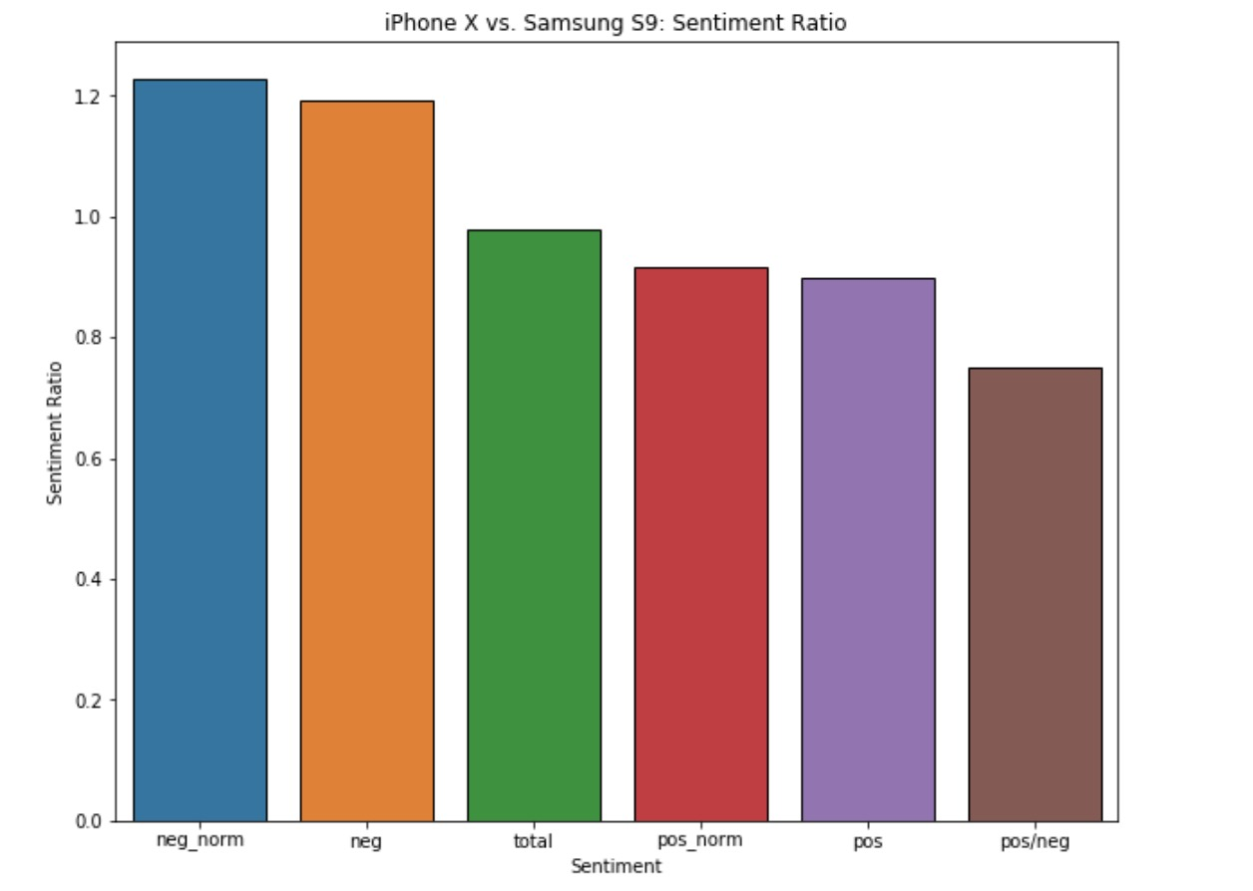
iPhone X vs. Samsung Galaxy S9

Slide 21
Next Steps
1. Set up a feature for standardized streaming of data that updates our datasets in intervals.
2. Develop a recommendation engine to recommend which aspects should are most actionable for product development based on our results.

Slide 22
Improvements
1. Collect more data
2. Combine synonyms as the same aspect, so that there aren’t duplicate information
3. The Algorithms have trouble interpreting some vocabulary like bigrams and trigrams, as well as very tech specific terminology, we need to make this vocab interpretable somehow.

Slide 23
Bibliography
"Apple iPhone sales 2018." Statista. Statista. 19 Feb. 2019 <https://www.statista.com/statistics/263401/global-apple-iphone-sales-since-3rd-quarter-2007/>.
Bansal, Shivam, and Natural Language Processing and Machine Learning. "Beginners Guide to Topic Modeling in Python." Analytics Vidhya. 11 Jan. 2019. 19 Feb. 2019 <https://www.analyticsvidhya.com/blog/2016/08/beginners-guide-to-topic-modeling-in-python/>.
Li, Susan. "Topic Modeling and Latent Dirichlet Allocation (LDA) in Python." Towards Data Science. 31 May 2018. Towards Data Science. 19 Feb. 2019 <https://towardsdatascience.com/topic-modeling-and-latent-dirichlet-allocation-in-python-9bf156893c24>.
Li, Susan. "Topic Modelling in Python with NLTK and Gensim – Towards Data Science." Towards Data Science. 30 Mar. 2018. Towards Data Science. 19 Feb. 2019 <https://towardsdatascience.com/topic-modelling-in-python-with-nltk-and-gensim-4ef03213cd21>.
Min, Peter. "Aspect-Based Opinion Mining (NLP with Python) – Peter Min – Medium." Medium.com. 06 June 2018. Medium. 19 Feb. 2019 <https://medium.com/@pmin91/aspect-based-opinion-mining-nlp-with-python-a53eb4752800>.
https://www.cs.uic.edu/~liub/FBS/sentiment-analysis.html
http://www.cs.technion.ac.il/~gabr/resources/data/wordsim353/
https://www.digitaltrends.com/
https://www.gizmodo.com/
https://www.techradar.com/

